Slide 1
OPERATING SYSTEMS
Razi Uddin
Lecture # 23

Slide 2


LOGICAL-VERSUS PHYSICAL-ADDRESS SPACE
An address generated by the CPU is commonly referred to as a logical address.
Whereas an address seen by the memory unit–that is, the one loaded into the memory-address register of the memory–is commonly referred to as the physical address.
In essence, logical data refers to an instruction or data in the process address space.
Whereas the physical address refers to a main memory location where instruction or data resides.

Slide 3
LOGICAL-VERSUS PHYSICAL-ADDRESS SPACE
The compile time and load time binding methods generate identical logical and physical addresses.
Whereas the execution time binding method results in different physical and logical addresses.
In this case we refer to the logical address as the virtual address.
The set of all logical addresses generated by a program form the logical address space of a process.
The set of all physical addresses corresponding to these logical addresses is a physical address space of the process.
The total size of physical address space in a system is equal to the size of its main memory.
The run-time mapping from virtual to physical addresses is done by a piece of hardware in the CPU, called the memory management unit (MMU)

Slide 4
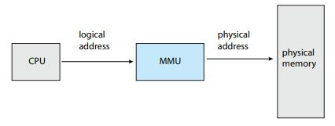

Slide 5
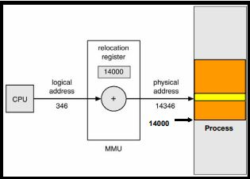
EXAMPLE

Slide 6
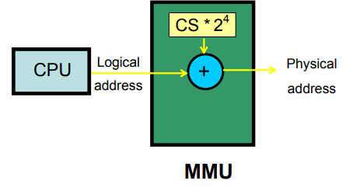
EXAMPLE (I8086)

Slide 7
EXAMPLE (I8086)
Logical address (16-bit)
IP = 0B10h CS = D000h
Physical address (20-bit)
CS * 2⁴ + IP = D0B10h

Slide 8
DYNAMIC LOADING
So far, it has been necessary for the entire program and all data of a process to be in physical memory for the process to execute.
The size of a process has thus been limited to the size of physical memory.
To obtain better memory-space utilization, we can use dynamic loading.
With dynamic loading, a routine is not loaded until it is called.
All routines are kept on disk in a relocatable load format.

Slide 9
DYNAMIC LOADING
The main program is loaded into memory and is executed.
When a routine needs to call another routine, the calling routine first checks to see whether the other routine has been loaded.
If it has not, the relocatable linking loader is called to load the desired routine into memory and to update the program’s address tables to reflect this change.
Then control is passed to the newly loaded routine.

Slide 10
DYNAMIC LOADING
Advantages:
Less time is needed to load a program.
Potentially less memory space is needed.
Disadvantages:
Run time activity.

Slide 11
DYNAMIC LINKING AND SHARED LIBRARIES
Some operating systems support only static linking in which system language libraries are treated like any other object module and are combined by the loader into the binary proper image.
The concept of dynamic linking is similar to that of dynamic loading.
Rather than the loading being postponed until execution time, linking is postponed until run-time.
This feature is usually used with system libraries.
Without this facility, all programs on a system need to have a copy of their language library included in the executable image.
This requirement wastes both disk space and main memory

Slide 12
DYNAMIC LINKING AND SHARED LIBRARIES
With dynamic linking, a stub is included in the image for each library-routine reference.
This stub is a small piece of code that indicates how to locate the appropriate memory-resident library routine or how to load the library if the routine is not already present.
During the execution of a process, the stub is replaced by the address of the relevant library code, and the code is executed.
If library code is not in memory, it is loaded at this time

Slide 13
DYNAMIC LINKING AND SHARED LIBRARIES
This feature can be extended to update libraries.
A library may be replaced by a new version and all programs that reference the library will automatically use the new version without any need to be re-linked.
More than one version of a library may be loaded into the memory and each program uses its version information to decide which copy of the library to use.
Only major changes increment the version number.
Only programs that are compiled with the new library version are affected by the incompatible changes incorporated in it.
Programs linked before the new library was installed will continue using the older library.
This system is also known as shared libraries.

Slide 14
DYNAMIC LINKING AND SHARED LIBRARIES
Advantages:
Less time is needed to load a program.
Potentially less memory space is needed.
Less disk space is needed to store binaries.
Updated libraries are used without recompilation of the program.
Disadvantage:
Time-consuming runtime activity.
Resulting in slower program execution.
gcc compiler performs dynamic linking by default
-static can be used for static linking.

Slide 15
OVERLAYS
To enable a process to be larger than the amount of memory allocated to it, we can use overlays.
The idea of overlays is to keep in memory only those instructions and data that are needed at any given time.
When other instructions are needed, they are loaded into space occupied previously by instructions that are no longer needed.
We illustrate the concept of overlays with the example of a two-pass compiler.

Slide 16
OVERLAYS
2-Pass assembler/compiler
Available main memory: 150k
Code size: 210k
Pass 1 ……………….. 70k
Pass 2 ……………….. 80k
Common routines …... 30k
Symbol table ………… 20k
Overlay driver………..10k

Slide 17
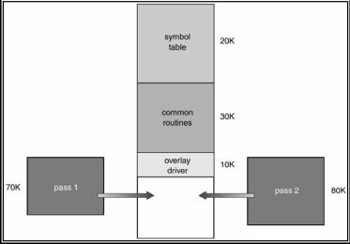
OVERLAYS

Slide 18
OVERLAYS
The problems with overlays are:
You may not be able to partition all problems into overlays.
The programmer is responsible for writing the overlays driver.

Slide 19
SWAPPING
A process needs to be in the memory to be executed.
A process, however, can be swapped temporarily out of memory to a backing store, and then brought back into memory for continued execution.
The backing store is a fast disk large enough to accommodate copies of all memory images for all users; it must provide direct access to these memory images.
The system maintains a ready queue of all processes whose memory images are on the backing store or in memory and are ready to run.

Slide 20
SWAPPING
Assume a multiprogramming environment with a round-robin CPU scheduling algorithm.
When a quantum expires, the memory manager will start to swap out the process that just finished and swap in another process to the memory space that has been freed.
A variant of this swapping policy can be used for priority-based scheduling algorithms.
If a higher-priority process arrives and wants service, the memory manager can swap out the lower-priority process so that it can load and execute the higher-priority process.
When the higher-priority process finishes, the lower-priority process can be swapped back in and continued.
This technique is called roll out, roll in.
The major part of swap time is transfer time (the total transfer time is directly proportional to the amount of memory swapped).

Slide 21
SWAPPING
Swapping is constrained by factors like quantum for RR scheduler and pending I/O for swapped out process.
Assume that the I/O operation was queued because the device was busy.
Then if we were to swap out P1, and swap in process P2, the I/O operation might attempt to access memory that now belongs to P2.
The solution to this problem are never to swap out processes with pending I/O
or to execute I/O in kernel space

Slide 22
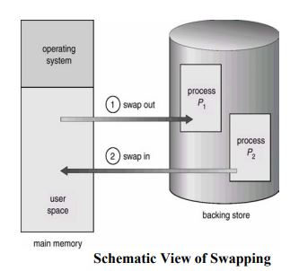
SWAPPING

Slide 23
SWAPPING
Cost of Swapping Process
Size = 1 MB
Transfer rate = 5 MB/sec
Swap out time = 1/5 sec = 200 ms
Average latency = 8 ms
Net swap out time = 208 ms
Swap out + swap in = 416 ms

Slide 24
CONTIGUOUS MEMORY ALLOCATION
The memory is usually divided into two partitions: one for the resident operating system and one for the user processes.
The operating system may be placed in the high memory or the low memory.
The position of the interrupt vector usually affects this decision.
Since the interrupt vector is often in the low memory, programmers place the OS in low memory too.
It is desirable to have several user processes residing in the memory at the same time.
In contiguous memory allocation, each process is contained in a single contiguous section of memory.
The base (re-location) and limit registers are used to point to the smallest memory address of a process and its size, respectively.

Slide 25
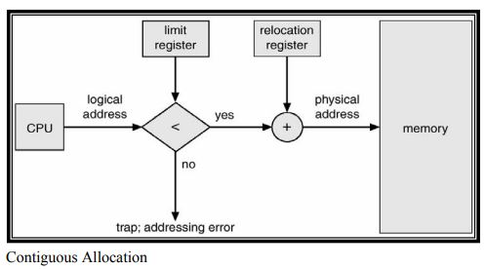
CONTIGUOUS MEMORY ALLOCATION

Slide 26
MULTIPROGRAMMING WITH FIXED TASKS (MFT)
In this technique, memory is divided into several fixed-size partitions.
Each partition may contain exactly one process.
Thus the degree of multiprogramming is bound by the number of partitions.
In this multiple partition method, when a partition is free, a process is selected from the input queue and is loaded in the free partition.
When the process terminates, the partition becomes available for another process.

Slide 27
MULTIPROGRAMMING WITH FIXED TASKS (MFT)
This was used by IBM for system 360 OS/MFT (multiprogramming with a fixed number of tasks).
Can have a single input queue instead of one for each partition.
So that if there are no big jobs can use big partition for little jobs.
Can think of the input queue(s) as the ready list(s) with a scheduling policy of FCFS in each partition.
The partition boundaries are not movable and are set at boot time (must reboot to move a job).
MFT can have large internal fragmentation, i.e., wasted space inside a region

Slide 28
MULTIPROGRAMMING WITH FIXED TASKS (MFT)
MFT with multiple queues involves load-time address binding.
In this technique, there is a potential for wasted memory space i.e. an empty partition but no process in the associated queue

Slide 29
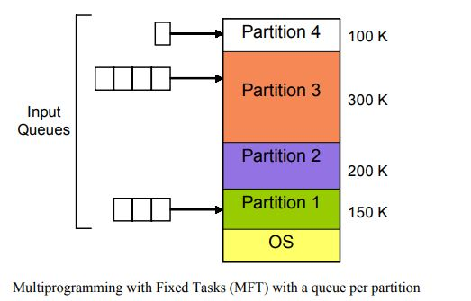
MULTIPROGRAMMING WITH FIXED TASKS (MFT)

Slide 30
MULTIPROGRAMMING WITH FIXED TASKS (MFT)
MFT with a single queue there is a single queue for each partition.
The queue is searched for a process when a partition becomes empty.
First-fit, best-fit, worst-fit space allocation algorithms can be applied here.

Slide 31
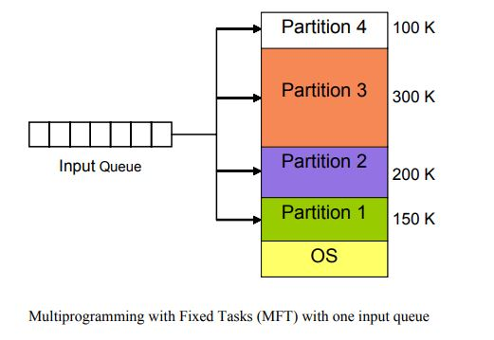
MULTIPROGRAMMING WITH FIXED TASKS (MFT)

Slide 32
MULTIPROGRAMMING WITH FIXED TASKS (MFT) ISSUES
Internal fragmentation—wasted space inside a fixed-size memory segment.
No sharing between processes.
Load-time address binding with multiple input queues.

Slide 33
MULTIPROGRAMMING WITH VARIABLE TASKS (MVT)
Job can move (might be swapped back in a different place).
This is dynamic address translation (during run time).
Must perform an addition on every memory reference (i.e. on every address translation) to add the start address of the partition.
Eliminates internal fragmentation.
Find a region the exact right size (leave a hole for the remainder).
Not quite true, can't get a piece with 10A755 bytes. Would get say 10A760.
But internal fragmentation is much reduced compared to MFT.
Indeed, we say that internal fragmentation has been eliminated.

Slide 34
MULTIPROGRAMMING WITH VARIABLE TASKS (MVT)
This is the generalization of the fixed partition scheme.
It is used primarily in a batch environment.
This scheme of memory management was first introduced in IBM OS/MVT (multiprogramming with a varying number of tasks).
Both the number and size of the partitions change with time.
Job still has only one segment (as with MFT) but now can be of any size up to the size of the machine and can change with time.
A single ready list.
Job can move (might be swapped back in a different place). This is dynamic address translation (during run time). Must perform an addition on every memory reference (i.e. on every address translation) to add the start address of the partition. Eliminates internal fragmentation. Find a region the exact right size (leave a hole for the remainder).

Slide 35
MULTIPROGRAMMING WITH VARIABLE TASKS (MVT)
Introduces external fragmentation, i.e., holes outside any region.
What do you do if no hole is big enough for the request?
Solution—Can compact memory

Slide 36
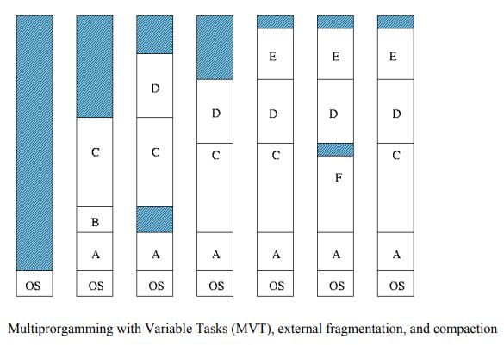
MULTIPROGRAMMING WITH VARIABLE TASKS (MVT)

Slide 37
EXTERNAL FRAGMENTATION
As processes come and go, holes of free space are created in the main memory.
External Fragmentation—refers to the situation when free memory space exists to load a process in the memory but the space is not contiguous.
Compaction eliminates external fragmentation by shuffling memory contents (processes) to place all free memory into one large block.
The cost of compaction is slower execution of processes as compaction takes place.

Slide 38
PAGING
All programs and data are composed of fixed-length units called pages i.e. logical memory is divided into blocks of the same size, called pages.
A block of words that occupy contiguous locations in main memory.
Constitute a basic unit of information that is transferred between the main memory and the disk.
Pages should not be too small.
Takes a considerable amount of time to locate the data on the disk.
Pages should not be too large.
Substantial portion of a page may not be used.
An area in the main memory that can hold one page is called a page frame i.e., Physical memory is broken down into fixed-sized blocks, called frames.

Slide 39
PAGING
The size of a page is a power of 2, the typical page table size lying between 1K and16K.
It is important to keep track of all free frames.
In order to run a program of size n pages, we find n free frames and load program pages into these frames.
In order to keep track of a program’s pages in the main memory a page table is used.
Every logical address generated by the CPU is divided into two parts:
Page number (p) (high-order bits)
And a page offset (d). (low-order bits)

Slide 40
PAGING
Information about main memory location of each page is kept in a page table.
Each entry in the page table includes some control bits:
One bit indicates the validity of the page.
Another bit indicates whether the page has been modified.
Other control bits indicate various restrictions that may be imposed on accessing the page.
The page table contains the base address (frame number) of each page in physical memory.
The frame number is combined with the page offset to obtain the physical memory address of the memory location that contains the object addressed by the corresponding logical address.
Here p is used to index the process page table; page table entry contains the frame number, f, where page p is loaded. The physical address of the location referenced by (p,d) is computed by appending d at the end of f, as shown below:

Slide 41
PAGING
The page table contains the base address (frame number) of each page in physical memory.
The frame number is combined with the page offset to obtain the physical memory address of the memory location that contains the object addressed by the corresponding logical address.
Here p is used to index the process page table; page table entry contains the frame number, f, where page p is loaded.
The physical address of the location referenced by (p,d) is computed by appending d at the end of f, as shown below:
f | d

Slide 42
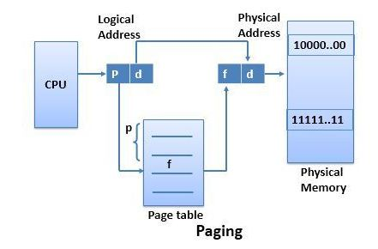
PAGING

